Slide 1
Ray: A Distributed Framework for Emerging AI Applications
Philipp Moritz, Robert Nishihara, Stephanie Wang, Alexey Tumanov, Richard Liaw, Eric Liang, Melih Elibol, Zongheng Yang, William Paul, Michael I. Jordan, Ion Stoica
University of California, Berkeley

Slide 2
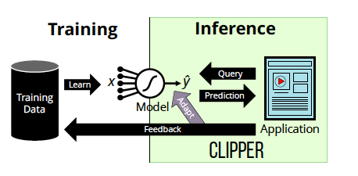
Background
Current AI applications: A model is trained offline and deployed to serve predictions online

Slide 3




Background
Emerging AI applications
Face dynamic environment and take actions in real-time
Aligned with the paradigm of reinforcement learning

Slide 4
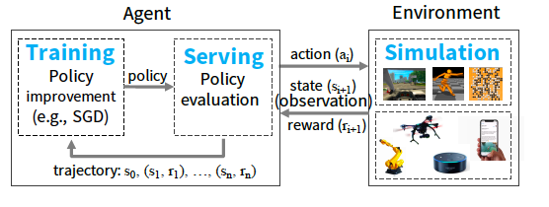
Background
Characteristics of RL system
Rely heavily on simulations
Heterogeneous and dynamic computation graph
Perform simulation and take actions in real-time

Slide 5
Requirements
Flexibility
Training, serving, simulation
Fine-grained, heterogeneous computation
Dynamic execution
Performance
Schedule tasks in real time
Significant use of simulations
Ease of development

Slide 6


Background
Existing cluster computing frameworks fall short
Do not meet the throughput and latency requirement
Assume bulk synchronous parallel (BSP) model

Slide 7


Background
Existing cluster computing frameworks fall short
Adopt static computation graph

Slide 8
Design of Ray
Programming and Computation Layer
Task model
Actor model
Application Layer
Driver
Worker
System Layer
Global Control Store
Bottom-up Distributed Scheduler
Actor

Slide 9
Programming and computation model
Dynamic task graph computation model
Task-parallel programming
Task: execution of a remote function on a stateless worker
Use future to represent the result of remote execution
Actor programming
Actor: a stateful process exposing methods that can be invoked
Useful for wrapping third-party simulators

Slide 10
Ray API
Name | Description
Futures = f.remote(args) | Execute function f() remotely. f() takes either object values or futures as arguments, and returns a list of futures. This is a non-blocking call.
Obj_list = ray.get(futures) | Return the values associated with a list of futures. This is a blocking call.
Ray.wait(futures, k, timeout) | Given a list of futures, return the futures whose corresponding tasks have completed as soon as either k of the tasks have completed or the timeout expires.
actor = Class.remote(args) Futures = actor.method.remote(args) | Instantiate class Class as a remote actor, and return a reference to it. Call a method on the remote actor and return a list of futures. This is a non-blocking call.

Slide 11
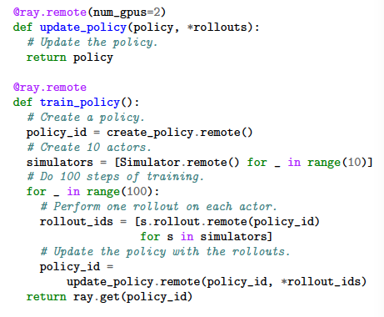
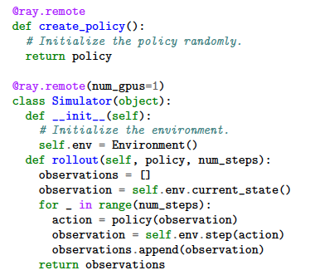
Example program
Actor
Task

Slide 12
Application layer architecture
Driver: A process executing the user program
Worker: A stateless process that executes tasks (remote functions) invoked by a driver or another worker
Actor: A stateful process that executes methods it exposes when invoked

Slide 13
System layer architecture
Decouple the storage of control plane information from the logic implementation
Global control store (GCS)
Bottom-up distributed scheduler
In-memory object store (Used to store inputs and outputs)

Slide 14
Global Control Store
Maintain the entire control state of the system, including:
Specification of every task
Code for every remote function
Computation graph
Current locations of all objects
Every scheduling event
Achieving properties
Fault tolerance
Low latency

Slide 15
Global Control Store

Slide 16
Bottom-up Distributed Scheduler
2-level hierarchical scheduler, with a global scheduler and per-node local schedulers
A task is first submitted to local scheduler
If the local scheduler decides not to schedule locally, forwards to the global scheduler
Schedule according to each node`s load and task`s constraints

Slide 17
Bottom-up Distributed Scheduler

Slide 18
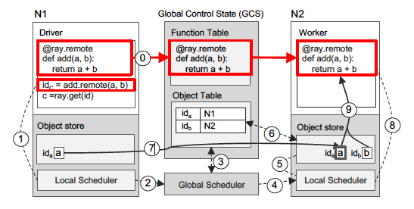
A Walk-through Example

Slide 19
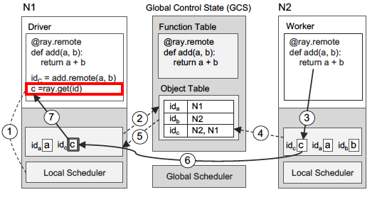
A Walk-through Example

Slide 20
Evaluation
Scalability
Fault tolerance
RL application performance

Slide 21
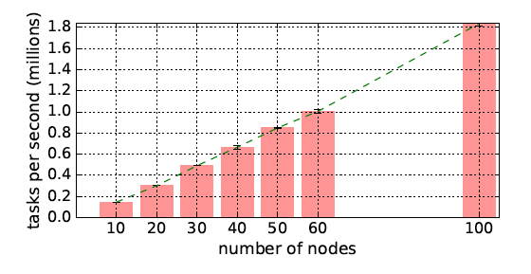
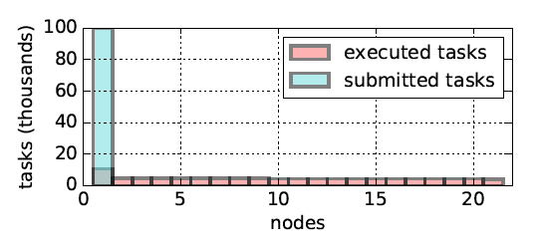
Scalability
End-to-end scalability
Load balancing

Slide 22
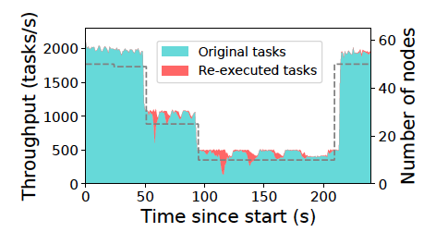
Fault tolerance
Nodes are killed at t=25s, 50s, 100s
Local scheduler reconstruct the results according to the lineage stored in GCS
Per-node throughput remains stable

Slide 23
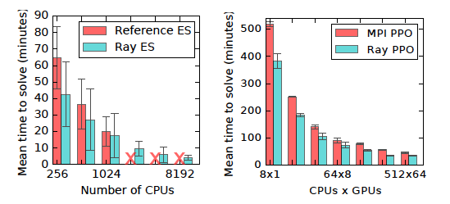
RL application performance
Ray outperforms systems specifically built for two algorithms: evolution strategies and proximal policy optimization (PPO)
Evolution Strategies
PPO

Slide 24
Conclusion
A dynamic task graph computation system tailored for RL applications
Useful for implementing systems using RL algorithms
Cluster scheduling for fine-grained heterogeneous tasks

